Slide 1
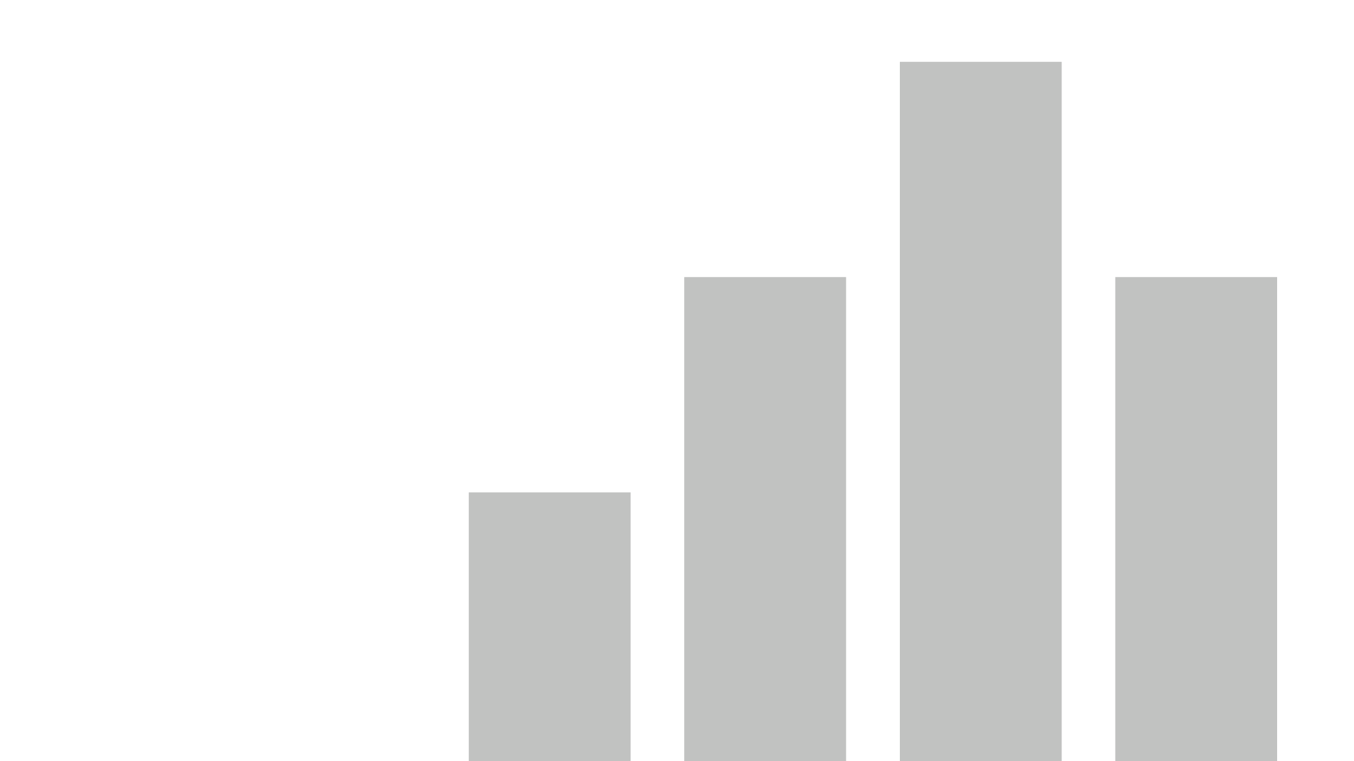


Social Media Analysis
View in Power BI
Last data refresh:
08/05/2025 13:19:05 UTC
Downloaded at:
08/05/2025 13:20:59 UTC

Slide 2
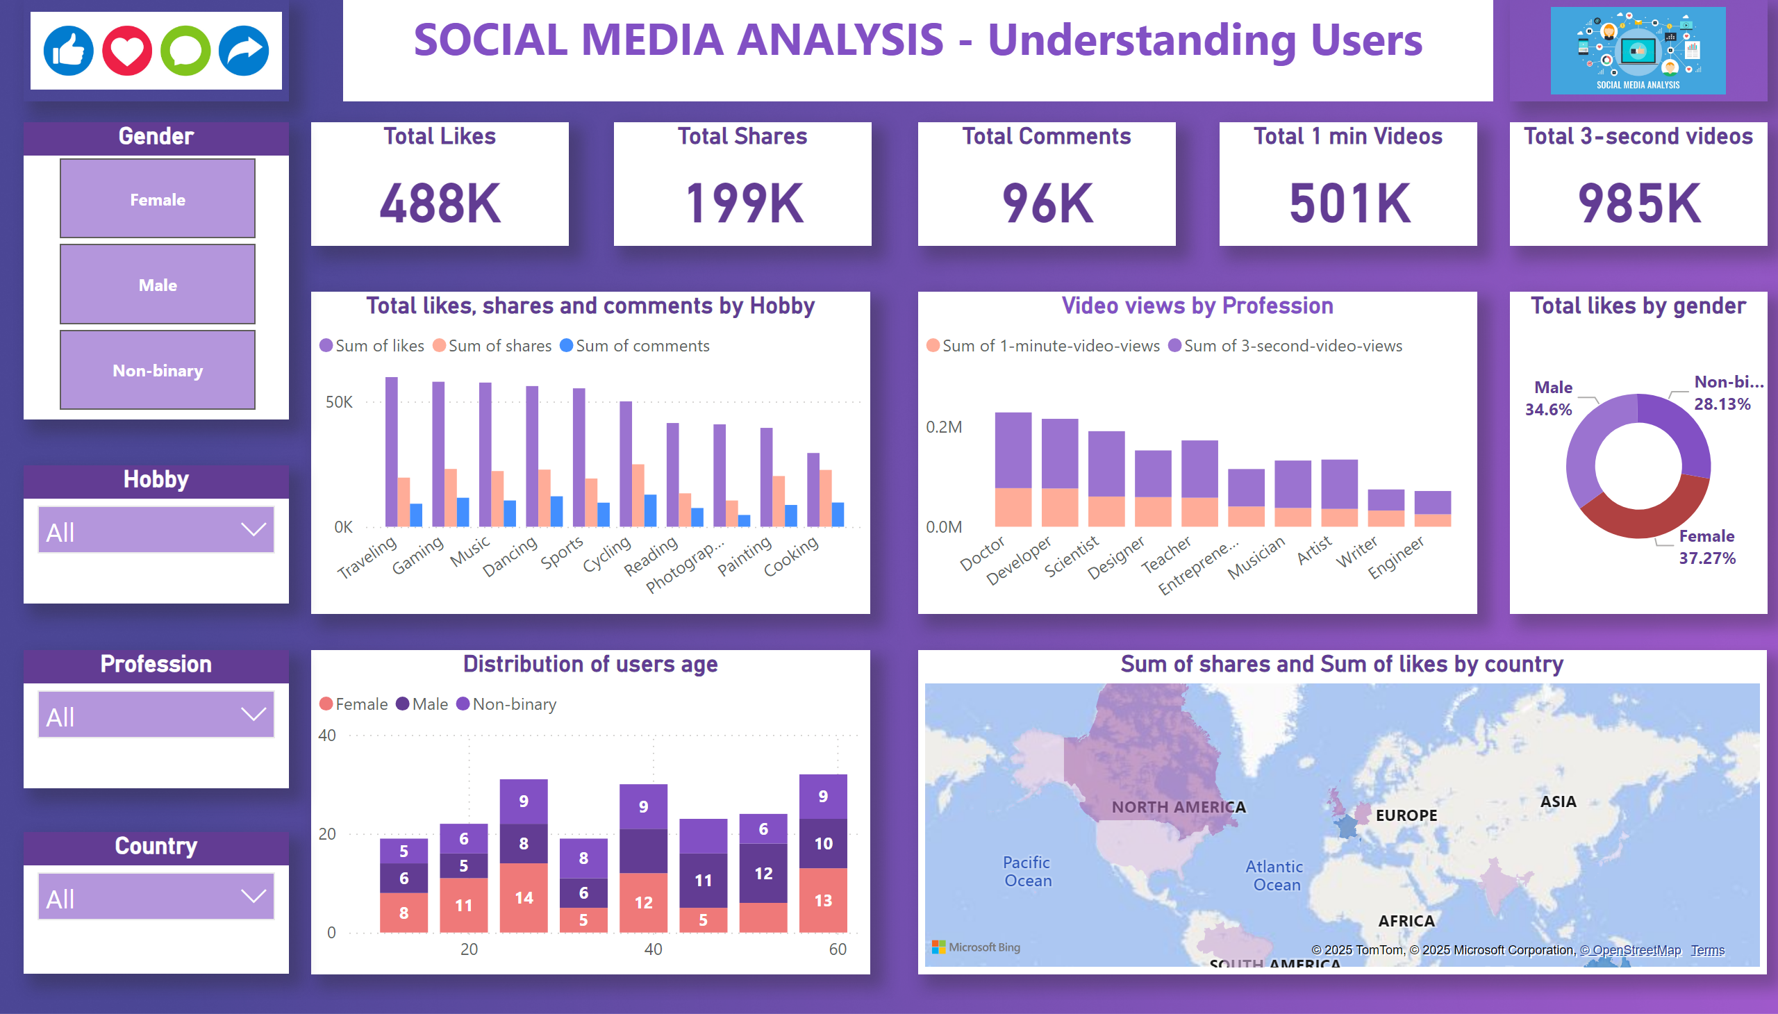
Dashboard
Notes:
textbox
No alt text provided
image
No alt text provided
image
No alt text provided
Total Likes
No alt text provided
Total Shares
No alt text provided
Total Comments
No alt text provided
Total 1 min Videos
No alt text provided
Total 3-second videos
No alt text provided
Total likes, shares and comments by Hobby
No alt text provided
Video views by Profession
No alt text provided
Total likes by gender
No alt text provided
Distribution of users age
No alt text provided
Gender
No alt text provided
Hobby
No alt text provided
Profession
No alt text provided
Country
No alt text provided
filledMap
No alt text provided

